Slide 1
Producer/Consumer
A Rust Recreation
May 17, 2023

Slide 2

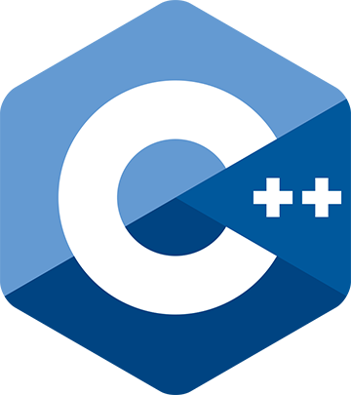
87%
Rust vs. C++
2022 Stack Overflow Developer Survey
“Rust is on its seventh year as the most loved language with 87% of developers saying they want to continue using it. Rust also ties with Python as the most wanted technology with TypeScript running a close second.”
48%
Notes:
Usage:
- C++ (23%)
- Rust (9%)

Slide 3
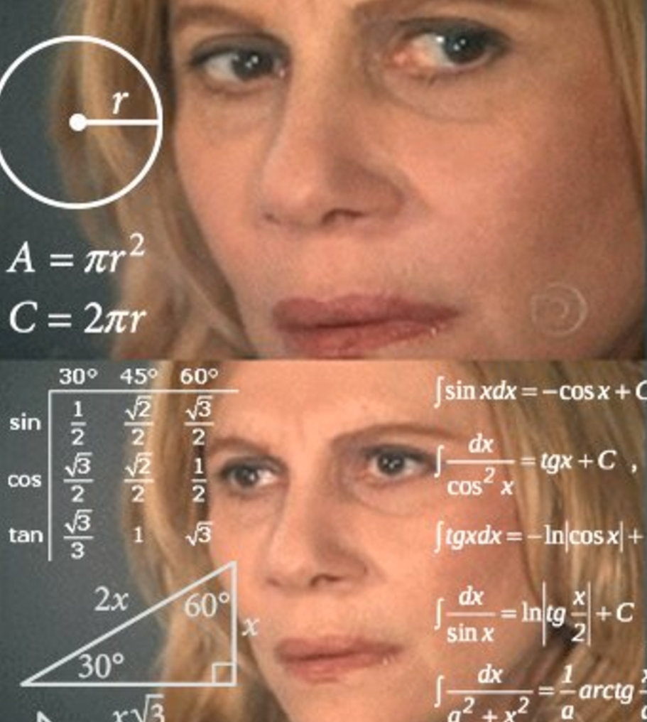



How learning Rust felt
Notes:
Ownership
Traits
Mutexes
Atomic reference counters

Slide 4
Recreation
With Rust-ic design
What ideals drove the recreation?
You will notice throughout the reconstruction of this project the ideals of clarity, safety, and efficiency; which is why I spent more time designing than programming.
Clarity
Renaming
File reorganization
Explicit type and mutability
Mode enum
Safety
Fearless concurrency
Local scoping
Mutex-locked fields
Atomic references
Efficiency
Multithreading
BTreeMap of accounts
FIFO Vec ledger
Implementing Display trait

Slide 5
Isi Bernoff ibernoff@umass.edu 413.545.5555
cics.umass.edu | ibernoff#0858

